Slide 1

#LifeKoKaroLift
PG Program in Software Development Engineering

Slide 2



Course : DevOps
Session On : Linux and Scripting
Instructor: Poonam Agarwal

Slide 3
Today’s Agenda
1
Linux Boot Process
2
Directory structure on Linux Machines
3
Exit Codes
4
Input/Output Redirection
5
Text Editors

Slide 4
Today’s Agenda
1
Users And Users Group
2
Types of file permissions: User, Group, Other
3
Symbolic Links hard and soft
4
Process and monitoring tools in linux
5
Memory Management in Linux

Slide 5
Linux BootUp Process
Module 1:
Boot process
Notes:
;

Slide 6
Linux BootUp Process
BIOS
BIOS
MBR
GRUB
Kernel
Systemd
MBR
GRUB
Kernel
Systemd
Notes:
;

Slide 7
Linux BootUp Process
BIOS
  POST (Power on safe test)
  ROM
  Independent of OS

Slide 8
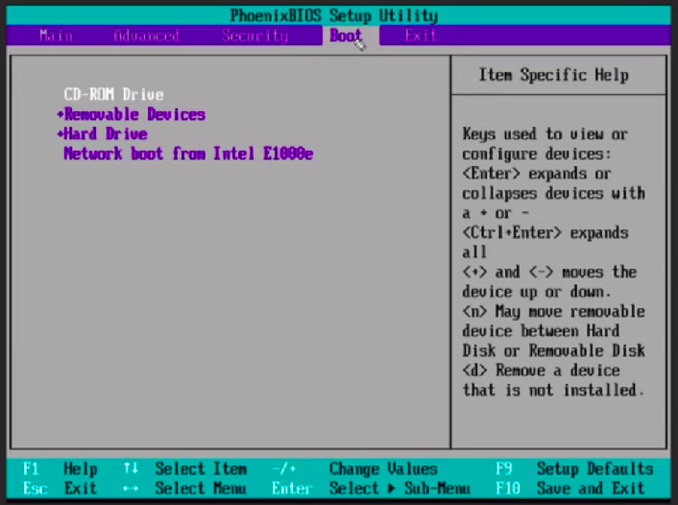
Linux BootUp Process

Slide 9
Linux BootUp Process
MBR
  Located on first sector of the drive (512 bytes)
  Contains Boot Loader as well as desk partitioning information.
  Invokes Boot Loader

Slide 10
Linux BootUp Process
BOOT Loader or GRUB
  Shows up list of available OS in the system
  It runs from RAM
  Executes Kernel

Slide 11
Linux BootUp Process
Kernel
  Core of OS initialization is done.
  Kernel may be compressed and this can be validated by doing ls for /boot/linuz
    Z for compression and without z is non compressed.
  Loads SystemD

Slide 12
Linux BootUp Process
Systemd
  Handles linux process
  Mounts Filesystem

Slide 13
Linux directory structure
Module 2:
About some general directories.
/etc
/proc
/bin
/dev
Important bash files: bash_logout

Slide 14
Linux directory structure
/etc: Host-specific system-wide configuration files.
/bin : Essential command binaries that need to be available in single user mode; for all users, e.g., cat, ls, cp.
/dev: Device files, e.g., /dev/null , /dev/disk0 , /dev/sda1 , /dev/tty , /dev/random.
/proc: Virtual filesystem providing process and kernel information as files. Generally automatically generated and populated by the system, on the fly.

Slide 15
Linux directory structure
/boot: Boot loader files eg. kernels, initrd
/lib: Libraries essentials for the business in /bin /sbin
/opt : Optional application software packages
/root: home directory for root user.
/var :Variable files - files whose content to continually change during normal operation of the system - such as logs spool files and temporary email files.

Slide 16
Module 3:
Exit Codes

Slide 17
Exit Codes
ExitCodeNumber | Meaning | Example | Comments
1 | Catch all for general errors | let “var1 = 1/0” | Miscellaneous errors, such as “divide by zero” and other impermissible operations.
2 | Misuse of shell builtins | empty_function() {} | Missing keyword or command
126 | Command invoked cannot execute | /dev/null | Permission problem or command is not an executable

Slide 18
Exit Codes
ExitCodeNumber | Meaning | Example | Comments
127 | “command not found” | illegal_command | Possible problem with $PATH or a typo
128 | Invalid argument to exit | exit 3.14159 | exit takes only integer args in the range 0 – 255
128 +n | Fatal error signal “n” | kill SIGTERM $PID of script | $? returns 143 (128 + 15)

Slide 19
Exit Codes
ExitCodeNumber | Meaning | Example | Comments
130 | Script terminated by Control-C | Ctrl-C | Control-C is fatal error signal 2, (130 = 128 + 2, see above)
255* | Exit status out of range | exit -1 | exit takes only integer args in the range 0 – 255

Slide 20
Exit Codes
“128 +n” with an example.
#!/bin/bash
while true; do
echo ${$}
done
sh test.sh
Ctrl + c
Echo $? → 130
Notes:
If you run this script it will print the same PID indefinitely untill you kill it or do a “CTRL+C”. Let try doing a “CTRL+C” and see what is the exit code.
# sh test.sh
....
2582
2582
2582
2582
2582
2582
^C
geeklab$ echo $?
130
As you can see the exit code is “128+2” i.e. 130. Similarly if we kill the script using “kill -9” the exit code should be “128+9” i.e. 137
kill -9 [pid_of_script]

Slide 21
Exit Codes
sh test.sh
Kill -9 [pid_of_script]
Echo $? → 137
Notes:
If you run this script it will print the same PID indefinitely untill you kill it or do a “CTRL+C”. Let try doing a “CTRL+C” and see what is the exit code.
# sh test.sh
....
2582
2582
2582
2582
2582
2582
^C
geeklab$ echo $?
130
As you can see the exit code is “128+2” i.e. 130. Similarly if we kill the script using “kill -9” the exit code should be “128+9” i.e. 137
kill -9 [pid_of_script]

Slide 22
Module 4:
I/O redirection
Command output redirection
Error redirection
Notes:
If you run this script it will print the same PID indefinitely untill you kill it or do a “CTRL+C”. Let try doing a “CTRL+C” and see what is the exit code.
# sh test.sh
....
2582
2582
2582
2582
2582
2582
^C
geeklab$ echo $?
130
As you can see the exit code is “128+2” i.e. 130. Similarly if we kill the script using “kill -9” the exit code should be “128+9” i.e. 137
kill -9 [pid_of_script]

Slide 23
I/O Redirection
keyboard is standard input (stdin) device.
The screen or a particular terminal window is the standard output (stdout) device.
However, since Linux is a flexible system, these default settings don't necessarily have to be applied. The standard output, for example, on a heavily monitored server in a large environment may be a printer.
Notes:
If you run this script it will print the same PID indefinitely untill you kill it or do a “CTRL+C”. Let try doing a “CTRL+C” and see what is the exit code.
# sh test.sh
....
2582
2582
2582
2582
2582
2582
^C
geeklab$ echo $?
130
As you can see the exit code is “128+2” i.e. 130. Similarly if we kill the script using “kill -9” the exit code should be “128+9” i.e. 137
kill -9 [pid_of_script]

Slide 24
I/O Redirection
I/O Redirection:
Output redirection
Input Redirection
Combining Redirection
Notes:
If you run this script it will print the same PID indefinitely untill you kill it or do a “CTRL+C”. Let try doing a “CTRL+C” and see what is the exit code.
# sh test.sh
....
2582
2582
2582
2582
2582
2582
^C
geeklab$ echo $?
130
As you can see the exit code is “128+2” i.e. 130. Similarly if we kill the script using “kill -9” the exit code should be “128+9” i.e. 137
kill -9 [pid_of_script]

Slide 25
I/O Redirection
Output redirection with > and |
$ cat test1
some words
$ cat test2
some other words
$ cat test1 test2 > test3
$ cat test3
some words
some other words
Notes:
If you run this script it will print the same PID indefinitely untill you kill it or do a “CTRL+C”. Let try doing a “CTRL+C” and see what is the exit code.
# sh test.sh
....
2582
2582
2582
2582
2582
2582
^C
geeklab$ echo $?
130
As you can see the exit code is “128+2” i.e. 130. Similarly if we kill the script using “kill -9” the exit code should be “128+9” i.e. 137
kill -9 [pid_of_script]

Slide 26
I/O Redirection
To find a word within some text, display all lines matching "pattern1", and exclude lines also matching:
"pattern2" from being displayed:
grep pattern1 file | grep -v pattern2
To display output of a directory listing one page at a time:
ls -la | less
To find a file in a directory:
ls -l | grep test2
Notes:
If you run this script it will print the same PID indefinitely untill you kill it or do a “CTRL+C”. Let try doing a “CTRL+C” and see what is the exit code.
# sh test.sh
....
2582
2582
2582
2582
2582
2582
^C
geeklab$ echo $?
130
As you can see the exit code is “128+2” i.e. 130. Similarly if we kill the script using “kill -9” the exit code should be “128+9” i.e. 137
kill -9 [pid_of_script]

Slide 27
I/O Redirection
Input redirection:
Most if not all commands get their input from standard input, and by default standard input is attached to the keyboard.
To redirect standard input from a file other than the keyboard, use the “<” operator as below:
$ cat < test1
some words
Notes:
If you run this script it will print the same PID indefinitely untill you kill it or do a “CTRL+C”. Let try doing a “CTRL+C” and see what is the exit code.
# sh test.sh
....
2582
2582
2582
2582
2582
2582
^C
geeklab$ echo $?
130
As you can see the exit code is “128+2” i.e. 130. Similarly if we kill the script using “kill -9” the exit code should be “128+9” i.e. 137
kill -9 [pid_of_script]

Slide 28
I/O Redirection
Combining redirections
The following example combines input and output redirection. The file text.txt is first checked for spelling mistakes, and the output is redirected to an error log file:
spell < text.txt > error.log
The following command lists all commands that you can issue to examine another file when using less:
less --help | grep -i examine

Slide 29
I/O Redirection
less --help | grep -i examine > examine-files-in-less
The >> operator
$cat wishlist
more money
$less work
date >> wishlist

Slide 30
I/O Redirection
Advanced redirection features
There are three types of I/O, which each have their own identifier, called a file descriptor:
• standard input: 0
• standard output: 1
• standard error: 2

Slide 31
I/O Redirection
In the following descriptions, if the file descriptor number is omitted, and the first character of the redirection
operator is <, the redirection refers to the standard input (file descriptor 0).
If the first character of the redirection operator is >, the redirection refers to the standard output (file descriptor 1).

Slide 32
I/O Redirection
Some practical examples will make this more clear:
ls > dirlist 2>&1
will direct both standard output and standard error to the file dirlist, while the command
ls 2>&1 > dirlist
will only direct standard output to dirlist. This can be a useful option for programmers.

Slide 33
I/O Redirection
Examples:
Analyzing errors
If your process generates a lot of errors, this is a way to thoroughly examine them:
$command 2>&1 | less
This is often used when creating new software using the make command, such as in:
$ ls -ltr 2>&1 | less
--output ommitted--

Slide 34
Using the Vim editor
vim and nano
Basic vim commands
Basic nano commands

Slide 35
Using the Vim editor
Vim is a highly configurable text editor built to make creating and changing any kind of text very efficient.
Vim is rock stable and is continuously being developed to become even better.
There are two modes vim operates on:
Command mode
Editor mode

Slide 36
Using the Vim editor
What makes vi confusing to the beginner is that it can operate in two modes: command mode and insert mode.
The editor always starts in command mode. Commands move you through the text, search, replace, mark blocks and perform other editing tasks, and some of them switch the editor to insert mode.
This means that each key has not one, but likely two meanings:
it can either represent a command for the editor when in command mode,
or a character that you want in a text when in insert mode.

Slide 37
Using the Vim editor
These are some popular vi commands:
• dd will delete n lines starting from the current cursor position.
• dw will delete n words at the right side of the cursor.
• x will delete the character on which the cursor is positioned
• :n moves to line n of the file.
• :w will save (write) the file.
• :q will exit the editor.
• :q! forces the exit when you want to quit a file containing unsaved changes.

Slide 38
Using the Vim editor
• :wq will save and exit
• :w newfile will save the text to newfile.
:wq! overrides
• /astring will search the string in the file and position the cursor on the first match below its position.
• / will perform the same search again, moving the cursor to the next match.

Slide 39
Using the Vim editor
• :%s/word/anotherword/g will replace word with anotherword throughout the file.
• yy will copy a block of text.
• p will paste it.
• :recover will recover a file after an unexpected interruption

Slide 40
Using the Vim editor
Commands that switch the editor to insert mode
• a will append: it moves the cursor one position to the right before switching to insert mode
• i will insert
• o will insert a blank line under the current cursor position and move the cursor to that line.

Slide 41
Using the Nano editor
To check if nano is present, simply use the following command:
nano --version
If its not present install Nano text editor on Debian or Ubuntu machine, execute the following command:
sudo apt-get install nano

Slide 42
Using the Nano editor
How to Use Nano Text Editor:
The main syntax to open Nano and to edit a certain file is:
nano demo.txt
or
nano /path/to/directory/demo.txt

Slide 43
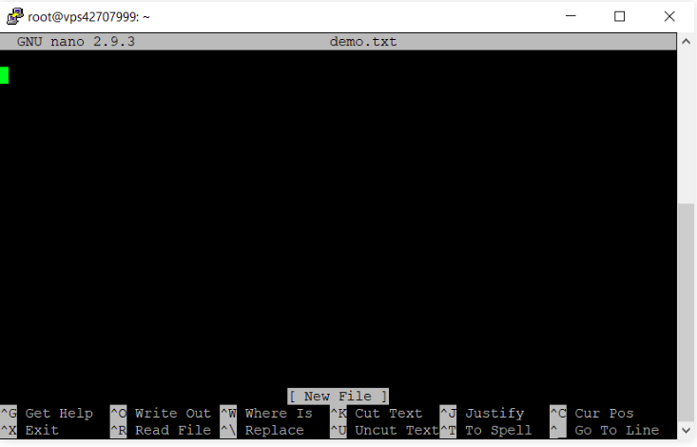
Using the Nano editor
Nano text editor looks like below image. Just use the arrow keys on your keyboard to move the cursor around the text.

Slide 44
Using the Nano editor
Some shortcuts to use with the Nano editor.
Here are a few examples.
Press CTRL + O to save the changes made in the file and continue editing.
To exit from the editor, press CTRL + X. If there are changes, it will ask you whether to save them or not. Input Y for Yes, or N for No, then press Enter.
But if there are no changes, you will exit the editor right away.

Slide 45
Using the Nano editor
How to Search and Replace Text
To search in the text, press CTRL + W. Insert your value and press Enter. To continue searching for the same text string, use ALT + W.
If your goal is to find and replace a text, press CTRL+W and then CTRL+R to enter the text that you want to search and the text that will replace it. The editor will then take you to the first instance of the text. You can press Y to replace one text or A to replace all instances.

Slide 46
Using the Nano editor
How to Edit Text
These are the commonly used shortcuts when editing a text in Nano.
To select text, go to the beginning of the desired text and press ALT + A. This will set a mark for selecting. Then, you can move over the text with arrow keys.
Press ALT + 6 to copy the selected text to the clipboard.
To cut the highlighted text, press CTRL + K.
If you want to paste the text, navigate to the intended place and press CTRL + U.

Slide 47
Using the Nano editor
Command Explanation
CTRL + A Lets you jump to the beginning of the line.
CTRL + E Lets you to jump to the end of the line.
CTRL + Y Scrolls page down.
CTRL + V Scrolls page up.
CTRL + G A Help window will pop out and show you all the available commands.
CTRL + O To save the file. Nano will ask you to edit or verify the desired file name.

Slide 48
Using the Nano editor
CTRL + W Search for a specified phrase in your text. Press ALT + W to search for the same phrase again.
CTRL + K It cuts the entire selected line to the cut buffer (similar to clipboard).
CTRL + U To paste the text from the cut buffer into the selected line.
CTRL + J Justifies the current paragraph.
CTRL + C Shows the current cursor position in the text (line/column/character).
CTRL + R Opens a file and inserts it at the current cursor position.

Slide 49
Using the Nano editor
CTRL + X To exit Nano text editor. It prompts a save request if you made any changes to the file.
CTRL + \ Replaces string or a regular expression.
CTRL + T Invokes the spell checker, if available.
CTRL + _ Lets you go to the specified line and column number.
ALT + A To select text. You can combine this command with CTRL + K to cut a specific part of the text to the cut buffer.

Slide 50
Using the Nano editor
• Opening multiple files
• Scrolling per line
• Undo/Redo
• Syntax coloring
• Line Numbering
Note that, Vim, in general, offers more advanced functionalities. However, both of them offer the essentials for editing system configuration files, programming, and text editing.

Slide 51
Module 6:
Users and User groups
Adding or removing a user.
Why are they required

Slide 52
Users and User group
Create a user
We can create a new user account by issuing the following command:
sudo useradd testuser
We can make sure that the user has been created :
id testuser
And the output will be something like this:
uid=1007(testuser) gid=1009(testuser) groups=1009(testuser)

Slide 53
Users and User group
This will show the user id and the groups that the user is currently in, usually, a new group with the same username is assigned to the user.
By opening the following file: /etc/passwd.
So we can issue cat /etc/passwd and we will see the new user that has been created.

Slide 54
Users and User group
After creating the user using the command above, you notice that no user directories have been created inside /home directory, which is not good since the user cannot log in to his account.
To create a new user with its directories, we can issue:
sudo useradd -m -s /bin/bash testuser
If you navigate to the /home directory, you notice that a new directory with the name testuser is created.

Slide 55
Users and User group
Afterwards, you need to set a new password to the testuser by:
sudo passwd testuser
We noticed that creating a new user takes a lot of commands to accomplish, so there is a command that automates everything:
sudo adduser testuser

Slide 56
Users and User group
Delete a user
Like the process of adding users, there are two commands that delete a user.
sudo userdel testuser
If you try that command, you will notice that the user directory has not been deleted and you need to delete it by yourself.
You can use this automated command to do everything for you:
sudo deluser --remove-home testuser

Slide 57
Users and User group
User groups
A group is a collection of users. The primary purpose of the groups is to define a set of privileges like read, write, or execute permission for a given resource that can be shared among the users within the group.
Create a group
You can see all of the groups you have by opening the following file:
cat /etc/group

Slide 58
Users and User group
Let’s create a group with the name of section by:
sudo groupadd section
Add user to a group
We will add the testuser user to the section group by:
sudo usermod -aG section testuser

Slide 59
Users and User group
Delete user from a group
You can delete the testuser from the group with:
sudo gpasswd -d testuser section
Delete a group
Let’s delete the previous group by:
sudo groupdel section

Slide 60
Users and User group
Module 7:
Types of file permissions: User, Group, other
What are the octal representation
Adding and removing the permissions using the octal characters.

Slide 61
Types of file permissions: User, Group, others
File permissions
Let’s start by talking about the ownership of Linux files.
User: the owner of the file (person who created the file).
Group: the group can contain multiple users. Therefore, all users in that group will have the same permissions. It makes things easier than assign permission for every user you want.
Other: any person has access to that file, that person has neither created the file, nor are they in any group which has access to that file.

Slide 62
Types of file permissions: User, Group, others
When you perform the following command:
ls -l
total 84
-rw-rw-r-- 1 poonam poonam 408 Jun 26 22:11 csv.py
-rw-rw-r-- 1 poonam poonam 0 Jul 1 14:10 domains.list
-rw-rw-r-- 1 poonam poonam 374 Jul 1 14:24 examine-files-in-less
. . . . . .

Slide 63
Types of file permissions: User, Group, others
We will work with this part “-rw-r–r–".
The characters mean:
‘r’ = read.
‘w’ = write.
‘x’ = execute.
‘-’ = no permission.
Then the permissions will be: -rwxrwxrwx.

Slide 64
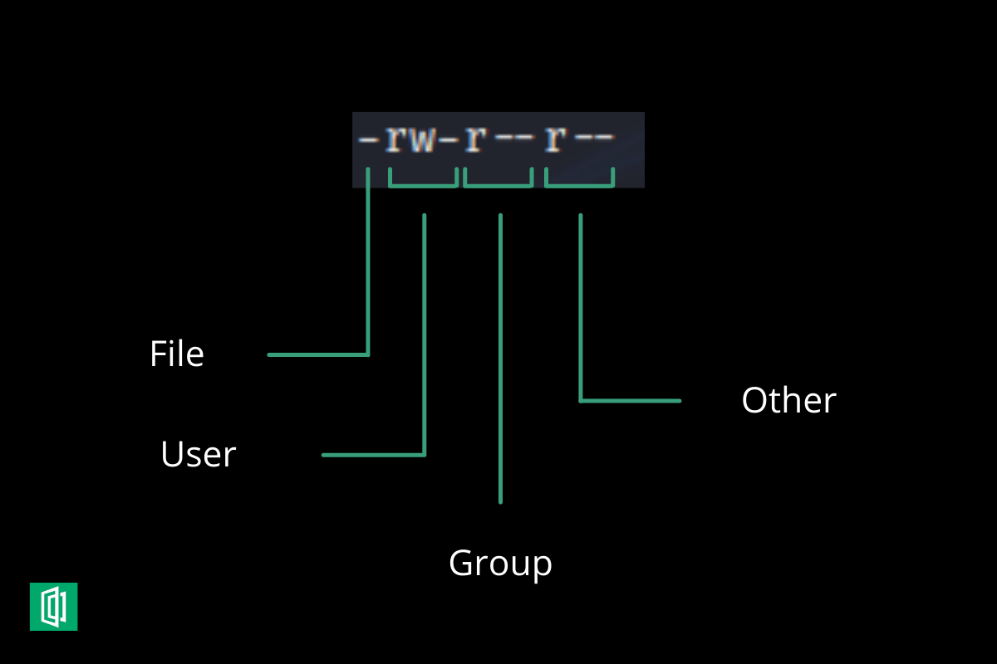
Types of file permissions: User, Group, others

Slide 65
Types of file permissions: User, Group, others
Let’s remove the execute from the group and the write from other by:
chmod 765 section.txt
The permissions will be: -rwxrw-r-x
r w x
4 2 1

Slide 66
Types of file permissions: User, Group, others
Module 8:
Symbolic links: hard and soft

Slide 67
Symbolic links: hard and soft
A link is nothing more than a way of matching two or more file names to the same set of file data. There are two ways to achieve this:
Hard link: Associate two or more file names with the same inode. Hard links share the same data blocks on the hard disk, while they continue to behave as independent files.
There is an immediate disadvantage: hard links can't span partitions, because inode numbers are only unique within a given partition.
Soft link or symbolic link (or for short: symlink): a small file that is a pointer to another file. A symbolic link contains the path to the target file instead of a physical location on the hard disk. Since inodes are not used in this system, soft links can span across partitions.

Slide 68
Symbolic links: hard and soft
Creating symbolic links
The symbolic link is particularly interesting for beginning users: they are fairly obvious to see and you don't need to worry about partitions.
The command to make links is ln. In order to create symlinks, you need to use the -s option:
ln -s targetfile linkname

Slide 69
Symbolic links: hard and soft
In the example below, user creates a link in a subdirectory of his home directory to a directory on another part of the system:
$ln -s /opt/vagrant/bin/vagrant newfile
$ ls -l
lrwxrwxrwx 1 poonam poonam 24 Jul 1 17:12 newfile -> /opt/vagrant/bin/vagrant
Symbolic links are always very small files, while hard links have the same size as the original file.

Slide 70
Module 9:
Process and monitoring tools in Linux
Process and threads
Different states of a process
Changing the priority of a process
Different ways of killing a process
Use of & in a script
Exit status of a shell

Slide 71
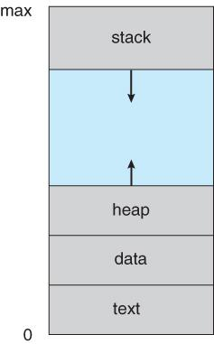
Process and Monitoring tools
A process is an instance of a program in execution.
Batch systems work in terms of "jobs". Many modern process concepts are still expressed in terms of jobs, ( e.g. job scheduling ), and the two terms are often used interchangeably.
Process memory is divided into four sections as shown here:
Text Section
Data Section
Heap section
Stack

Slide 72
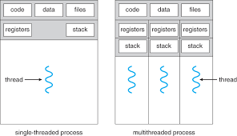
Process and Monitoring tools

Slide 73
Process and Monitoring tools
Process | Threads
A process is heavyweight. | A thread is a lightweight process also called an LWP.
A process has its own memory | A thread shares the memory with the parent process and other threads within the process.
Inter-process communication is slower due to isolated memory. | Inter-thread communication is faster due to shared memory.
Context switching between processes is expensive due to saving old and loading new process memory and stack info. | Context switching between threads is less expensive due to shared memory.

Slide 74
Process and Monitoring tools
You can change the scheduling priority of a running process to a value lower or higher than the base scheduling priority by using the renice command from the command line. This command changes the nice value of a process.
Note: To run a process at a higher priority or to change the priority for a process that you did not start, you must have root user authority.

Slide 75
Process and Monitoring tools
To change the priority of a running process, type the following:
renice <Priority> -p <ProcessID>
where Priority is a number in the range of -20 to 20. The higher the number, the lower the priority. If you use zero, the process will run at its base scheduling priority. ProcessID is the PID for which you want to change the priority.

Slide 76
Process and Monitoring tools
$ python3 continuous.py &
$ ps -fl -C "python3 continuous.py"
F S UID PID PPID C PRI NI ADDR SZ WCHAN STIME TTY TIME CMD
0 R poonam 11690 10921 97 80 0 - 4571 - 19:42 pts/0 00:00:30 python3 continuous.py

Slide 77
Process and Monitoring tools
Processes end because they receive a signal. There are multiple signals that you can send to a process.
Use the kill command to send a signal to a process. The command kill -l shows a list of signals.
Most signals are for internal use by the system, or for programmers when they write code.

Slide 78
Process and Monitoring tools
Signal name | Signal number | Meaning
SIGTERM | 15 | Terminate the process in an orderly way.
SIGINT | 2 | Interrupt the process. A process can ignore this signal.
SIGKILL | 9 | Interrupt the process. A process can not ignore this signal.
SIGHUP | 1 | For daemons: reread the configuration file.

Slide 79
Process and Monitoring tools
Use of ampersand & :
If a command is terminated by the control operator & , the shell executes the command in the background in a subshell.
The shell does not wait for the command to finish, and the return status is 0.
sh my_script.sh &

Slide 80
Process and Monitoring tools
Exit status of a shell:
Every Linux or Unix command executed by the shell script or user has an exit status.
Exit status is an integer number.
0 exit status means the command was successful without any errors.
Non zero errored output.

Slide 81
Memory management
Memory management in linux
Mounting
Unmounting
Shared File System
Formatting of a corrupted File System

Slide 82
Memory management
$ mount [-t fstype] filesystem mountpoint
For example, you have added a disk /dev/xvdf on on your system.
Now you want to mount this on /data directory.
Use following command to mount it.
$ mount -t xfs /dev/xvdf /data
Mount command automatically detects the file system on disk. But in some cases, you need specify the file system type with command.
$ mount -t xfs /dev/xvdf /data

Slide 83
Memory management
Unmount Filesystem
Use umount command to unmount any mounted filesystem on your system. Run umount command with disk name or mount point name to unmount currently mounted disk.
$ umount /data

Slide 84
Memory management
Mount Disk on System Boot
You also required to mount disk on system boot. So that partitions will be available on system boot. /etc/fstab file is used to mount disks.
You need to edit /etc/fstab and make new entry to mount the partitions automatically.
Edit /etc/fstab and append below line at end of file. Change /dev/sdb with your disk name.
/dev/xvdf /data xfs defaults 0 0
Now run mount -a command to immediate mount all disk defined in /etc/fstab file.
$ mount -a

Slide 85
Memory management
The network file system NFS enables you to share files and directories among systems in a network.
NFS is based on client-server architecture; the NFS server shares the specific directories which client can connect and access by mounting them locally.
With NFS, the mounted directory appears as if it resides on your local system.

Slide 86
Memory management
Before you move ahead, make sure the following pre-requisites are completed on the remote server.
NFS server is installed on the remote machine
NFS Service is running
NFS shared directory is exported
A firewall is not blocking access to client IP

Slide 87
Memory management
Server side commands
$ sudo apt install nfs-kernel-server
$ sudo mkdir /mnt/sharedfolder/
$ sudo vi /etc/exports
    /mnt/sharedfolder/ *(rw,sync)
$ sudo exportfs -a
$ sudo /etc/init.d/nfs-kernel-server start

Slide 88
Memory management
Client system
$ sudo apt update
$ sudo apt install nfs-common
$ sudo mkdir -p /mnt/client_sharedfolder
sudo mount [NFS _IP]:/[NFS_export] [Local_mountpoint]
$ sudo mount 54.69.61.208:/mnt/sharedfolder /mnt/client_sharedfolder
$ df -h
$ cd /mnt/client_sharedfolder
$ ls

Slide 89
Memory management
Formatting of a corrupted File System
fsck (file system check) is a command-line utility that allows you to perform consistency checks and interactive repairs on one or more Linux file systems.
You can use the fsck command to repair corrupted file systems in situations where the system fails to boot, or a partition cannot be mounted.

Slide 90
Memory management
The fsck command takes the following general form:
fsck [OPTIONS] [FILESYSTEM]
When no FILESYSTEM is provided as an argument, fsck checks the devices listed in the fstab file.
Never run fsck on mounted partitions as it may damage the file system. Before attempting to check or repair file systems always unmount it first.

Slide 91
Memory management
Unmount the device:
$sudo umount /data
Run fsck to repair the file system:
$sudo fsck -p /dev/xvdf
The -p option tells fsck to automatically repair any problems that can be safely fixed without user intervention.
Once the file system is repaired, mount the partition:
$sudo mount /dev/xvdf /data

Slide 92
#LifeKoKaroLift
Thank You!

